Slide 1

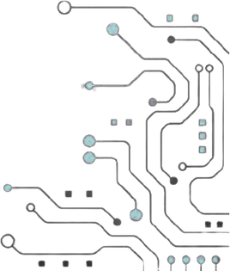



TEAM NAME:RTL REBELS
PROBELEM STATEMENT NO: PS 06
PROBLEM STATEMENT TITLE: HARDWARE AES-128 SYMMETRIC
BLOCK CIPHER CORE WITH AXI-MM INTERFACE
PS CATEGORY : HARDWARE

Slide 2
Problem Statement
Real-World Problems:
Modern FPGA/SoC systems demand high-speed symmetric cryptographic acceleration for data-in-transit and data-at-rest.
Software encryption throttles CPU throughput and exposes critical keys to side-channel and memory snooping attacks.
Why It Matters:
Secures high-bandwidth streaming channels (Ethernet, PCIe, DMA) with low-latency hardware cipher engines.
Essential for defense, aerospace, financial transaction processing, and secure IoT edge gateways.
Current Industry & Hardware Challenges:
Area vs. Throughput Bottleneck: Unrolled pipelines consume excessive LUTs (>10,000 LUTs), while simple micro-engines suffer high latency (>40 cycles).
Memory Constraints: Many implementations rely on pre-computed BRAM tables, violating zero-BRAM rules and risking memory dump attacks.
System Bus Vulnerabilities: Standard AXI peripherals lack hardware-enforced cryptographic boundaries, risking secret key and intermediate round leakage.
Protocol Limitations: Most designs only support basic ECB mode without cipher feedback, counter modes, or authentication.
.

Slide 3
Our Solution
Project Name: Secure & Resource-Optimized AES-128 FPGA Accelerator with 6-Mode Operating Subsystem.
One-Line Solution: A high-throughput (1.28 Gbps), cryptographically isolated AES-128 accelerator featuring a Full AXI4-MM burst interface, dynamic pipeline folding, on-the-fly round key generation, and a 6-mode NIST operating engine on Digilent 7-Series FPGA.
How It Solves the Problem:
Dynamic Pipeline Folding & Resource-Sharing: Single-round folded datapath with shared forward/inverse S-Box ROMs achieving 1 block / 10 cycles with low LUT utilization and 0 BRAM / 0 DSP.
Full AXI4-MM System Interface: Full memory-mapped slave supporting single and 4-beat burst transfers (INCR), ID reflection, and backpressure handshakes.
Cryptographic Isolation Boundary: Write-only key registers, gated outputs during computation, and strict isolation preventing bus probing or state leakage.

Slide 4
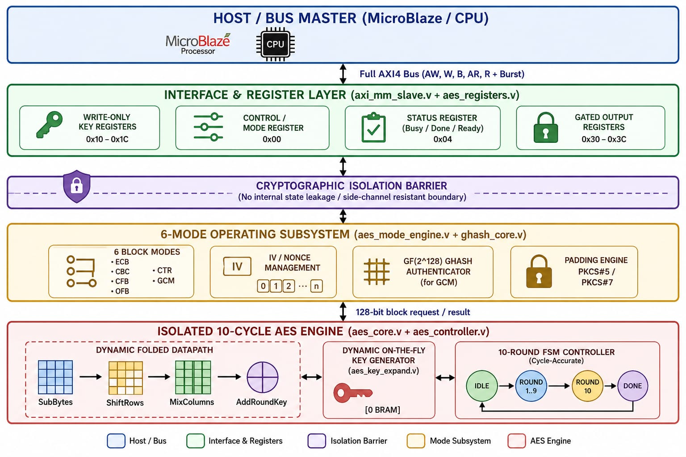
Architectural
Block diagram

Slide 5
Purpose of Blocks
Full AXI4-MM Interface (axi_mm_slave.v): Handles single/burst read/write transactions (INCR/FIXED), transaction IDs, and bus handshaking.
Cryptographic Isolation Boundary (aes_registers.v): Provides write-only key security (reads return 0x0000_0000) and masks ciphertext output until DONE == 1.
6-Mode & Padding Subsystem (aes_mode_engine.v + ghash_core.v): Coordinates chaining (CBC/CFB/OFB), counter increments (CTR/GCM), GHASH authentication tag generation, and PKCS#5 padding.
Folded Datapath Engine (aes_core.v): Executes unified forward/inverse SubBytes, ShiftRows, MixColumns, and AddRoundKey iteratively in 10 clock cycles.
On-the-Fly Key Generator: Generates the AES round keys K₁ to K₁₀ when needed, without storing them in BRAM, which saves hardware resources.
Architecture Trade-Offs
Pipeline Folding vs. Full Unrolling: Achieves 1.28 Gbps throughput while reducing area by >75% compared to unrolled 10-stage pipelines.
Full AXI4 Burst vs. AXI-Lite: Enables 4-word burst transfers, eliminating bus turnaround overhead and saturating datapath throughput.
Shared S-Box Architecture: Unifies forward and inverse S-boxes into shared distributed ROMs with MuxF7/F8 cascades to minimize slice footprint.

Slide 6
Outputs and ResultS
Post-Route Timing Closure
The AES-128 core operates successfully at 100 MHz with positive WNS and WHS, achieving 100% timing closure with zero failing endpoints.
High Throughput Performance
The core completes one 128-bit AES block in 10 clock cycles, achieving a sustained throughput of 1.28 Gbps.
Ultra-Compact Resource Utilization
The design uses only 4.01% LUTs and 0.63% registers, with 0 BRAM and 0 DSP48 slices, making it a pure logic-based implementation.
Power Consumption
The total on-chip power consumption is only 0.199 W (199 mW)
Verification and Standards Compliance
The design achieved 100% PASS in 284 NIST CAVP test vectors and verified all six AES operating modes successfully.
Security Verification
The design ensures write-only key protection, gated outputs during BUSY, and no internal state leakage through the AXI bus.
Hardware Demonstration
The AES core was demonstrated on the Digilent Nexys A7 (XC7A100T) using Python USB-UART streaming, 7-segment display, LEDs, and pushbuttons.

Slide 7
References
NIST FIPS 197: Advanced Encryption Standard (AES) — National Institute of Standards and Technology.
NIST SP 800-38A: Recommendation for Block Cipher Modes of Operation (ECB, CBC, OFB, CFB, CTR).
NIST SP 800-38D: Recommendation for Block Cipher Modes of Operation: Galois/Counter Mode (GCM) and GMAC.
RFC 2898 / RFC 5652: PKCS #5: Password-Based Cryptography / PKCS #7: Cryptographic Message Syntax (Padding).
ARM AMBA® AXI and ACE Protocol Specification: AXI4 Memory-Mapped Protocol (ARM IHI 0022E).
AMD / Xilinx UG900 & UG902: Vivado Design Suite User Guide: Logic Simulation, Synthesis, and Implementation.

